Slide 1


Slide 2
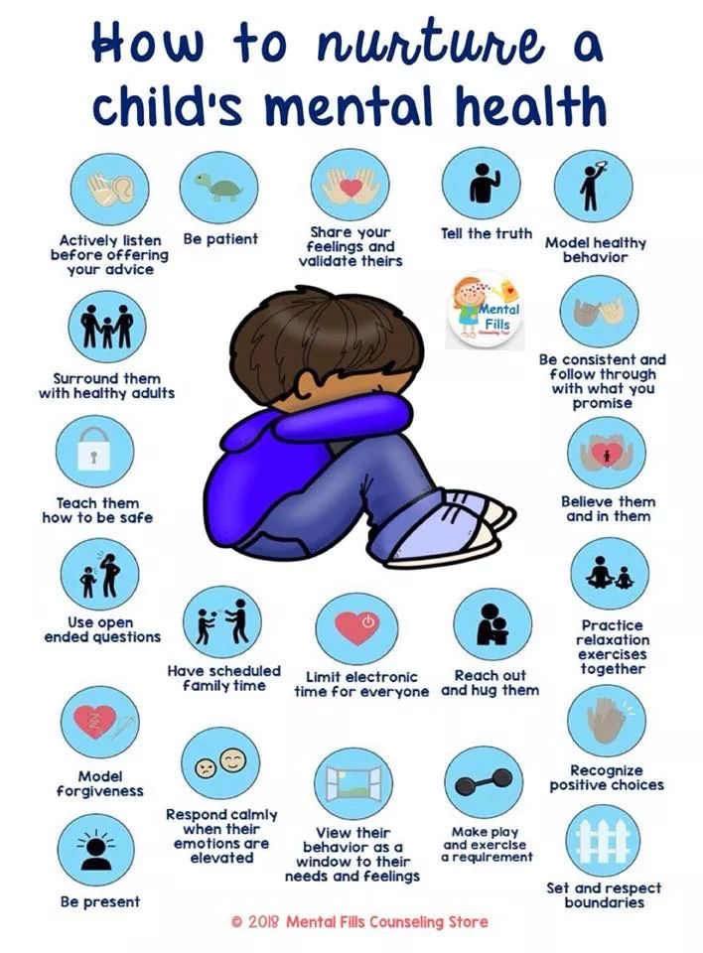

Slide 3


Slide 4


Slide 5


Slide 6


Slide 7


Slide 8
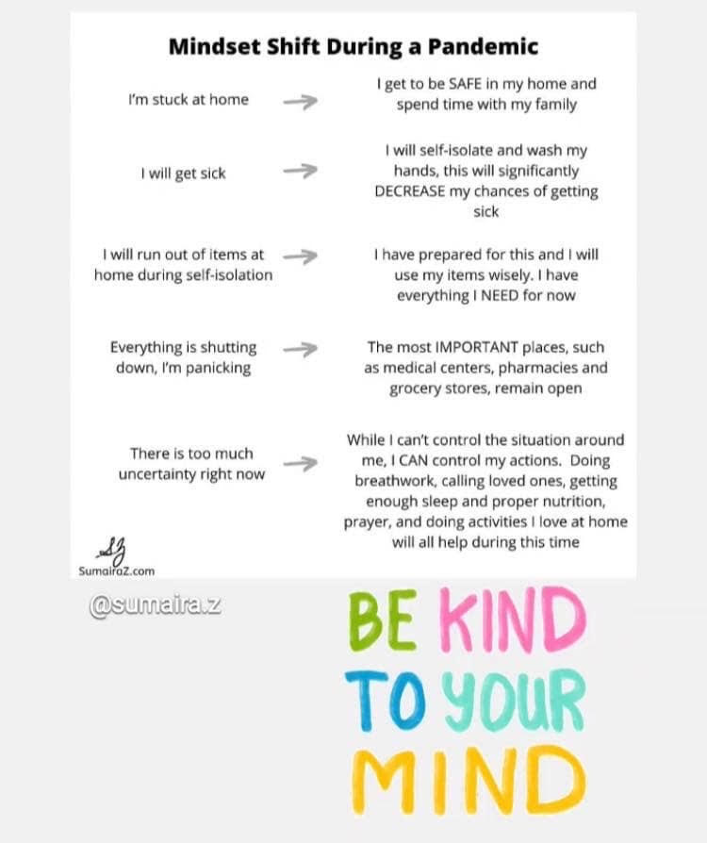

Slide 9


Slide 10

Thank you!
Join us Friday for Part 2

Slide 11

https://horttrades.com/covid-19-resources

